Slide 1
Machine Learning Balaji.M

Slide 2
Agenda
Overview of ML
Applications of ML
Types of ML
ML Algorithm Example – Linear Regression
Demo with Linear Regression algorithm

Slide 3
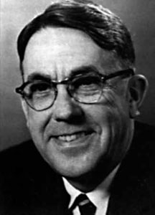
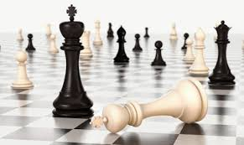
Overview of Machine Learning
Subfield of artificial intelligence (AI).
Automate decision-making processes based on data inputs.
Definitions:
The field of study that gives computers the
ability to learn without being explicitly programmed.
Arthur
Arthur Samuel

Slide 4
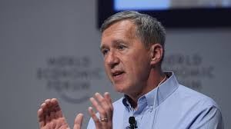
Overview of Machine Learning
A computer program is said to learn
from experience E with respect to some
class of tasks T and performance measure
P, if its performance at tasks in T, as
measured by P, improves with
experience E.
Tom Mitchell

Slide 5
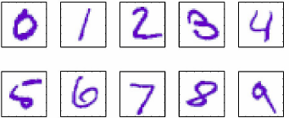
Overview of Machine Learning
Example: Digit Recognition
Task(T):
Recognizing and classifying handwritten words within images
Performance measure(P):
Percent of words correctly classified
Training experience(E):
A database of handwritten words with given classifications

Slide 6
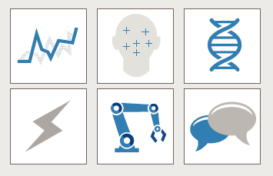
Real time Applications
Image processing and computer
vision
Computational biology
Natural language processing
Finance
Manufacturing Industry
Energy production, for price and
load forecasting

Slide 7
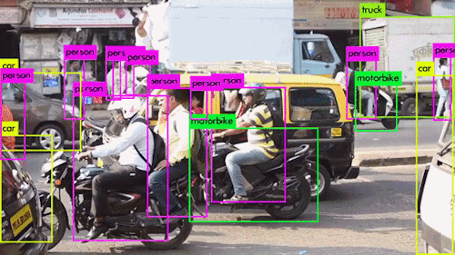
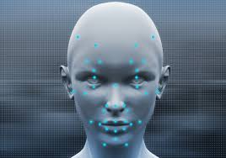

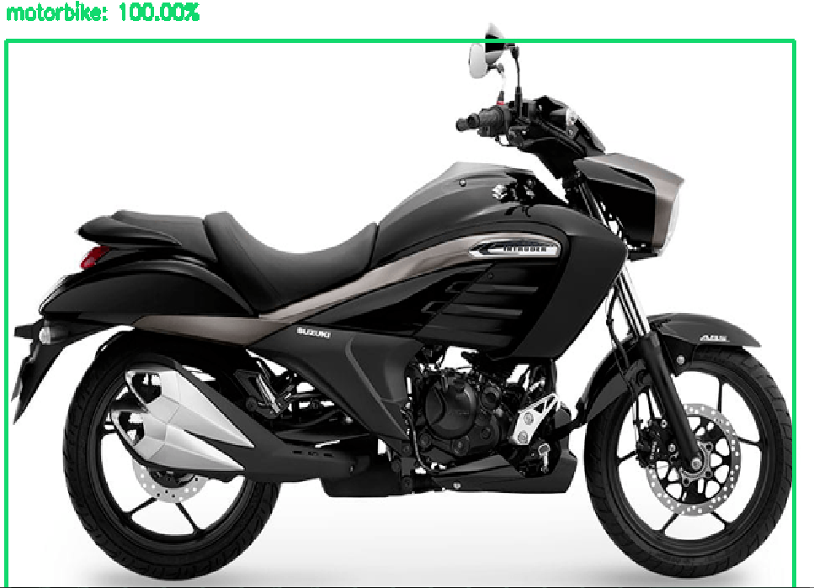
Real time Applications

Slide 8

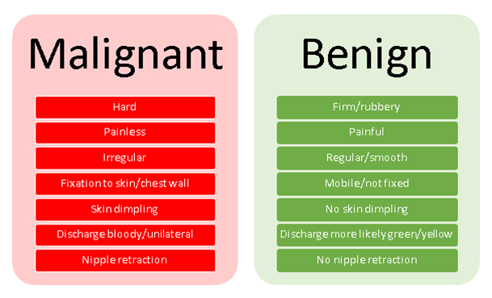

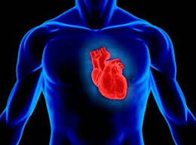
Real time Applications

Slide 9


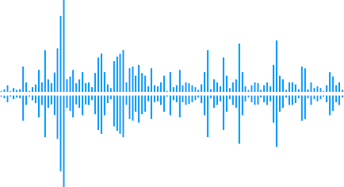
Real time Applications
Natural language processing

Slide 10
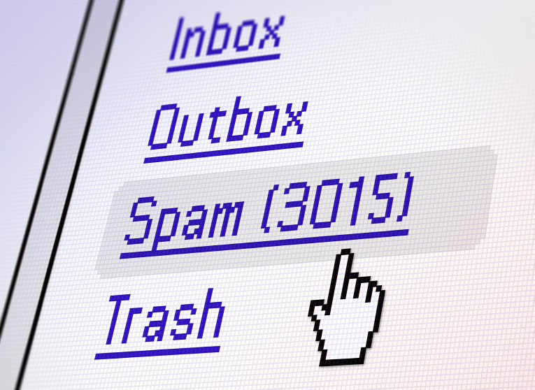
Real time Applications

Slide 11
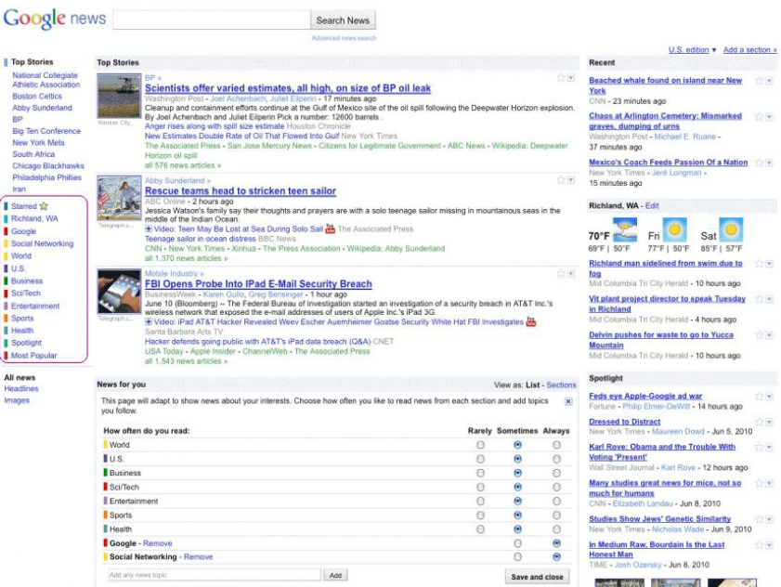
Real time Applications

Slide 12

Real time Applications

Slide 13
Types of Learning Algorithms
Supervised Learning
Learning algorithm Unsupervised Learning
Reinforcement Learning

Slide 14
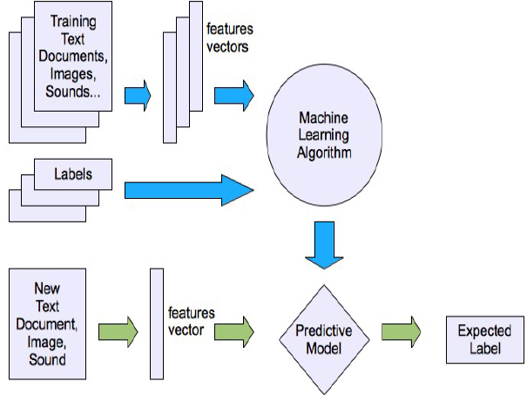
Supervised Learning
Supervised learning - Input and desired output data are provided

Slide 15
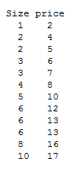
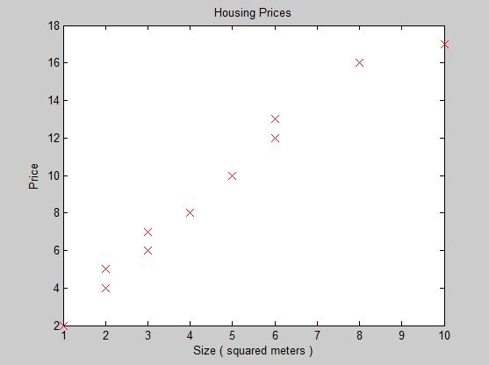
Supervised Learning

Slide 16
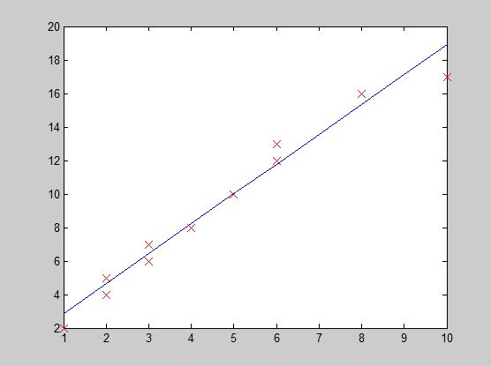
Supervised Learning

Slide 17
Supervised Learning
Algorithm takes a known set of input data and known responses to the data (output) and trains a model to generate reasonable predictions for the response to new data.
Category:
Classification techniques
Regression techniques
Example:
Linear regression
Logistic regression
Support vector machines

Slide 18
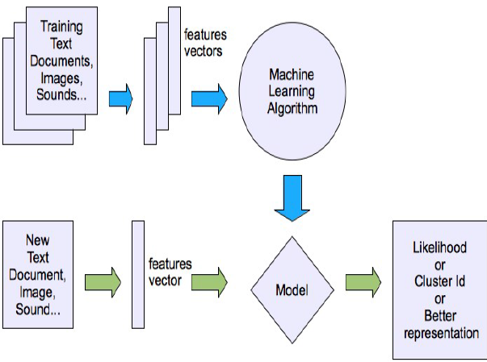
Unsupervised Learning
Unsupervised learning is where you only have input data and no corresponding output variables.

Slide 19
Unsupervised Learning
Categories:
Clustering: A clustering problem is where you want to discover the inherent groupings in the data, such as grouping customers by purchasing behaviour.
Association: An association rule learning problem is where you want to discover rules that describe large portions of your data, such as people that buy X also tend to buy Y.
Example:
K-means learning Algorithm for clustering problems

Slide 20
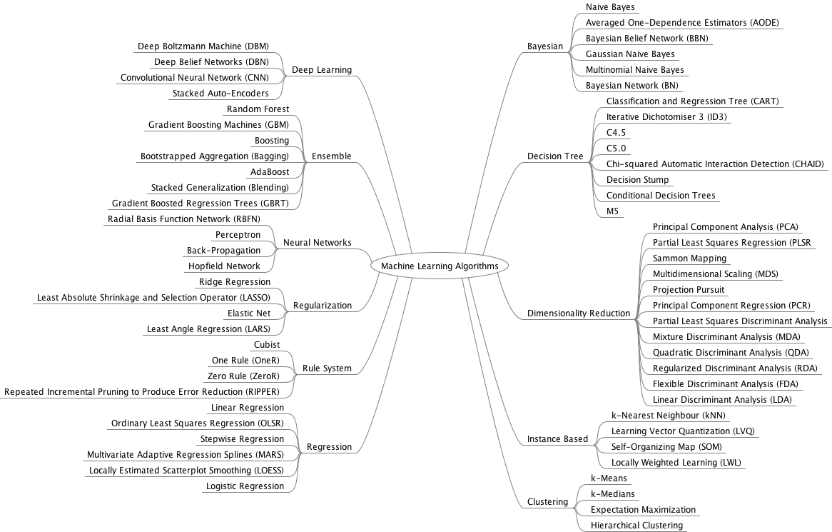
List of Learning Algorithms

Slide 21
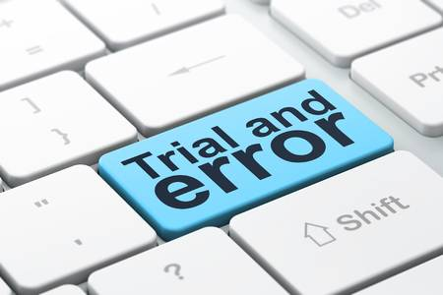

How to Choose a Suitable Algorithm?

Slide 22
Linear Regression – Learning Algorithm
Linear regression refers predicting the output within a continuous output and it is calculated analytically using linear algebra.
Notation used:
X- Input data
Y-Output data
m- Number of training examples
(x,y) – one training example
((x)^{(i)},(y)^{(i)}) – i^{th} training example

Slide 23
Linear Regression – Learning Algorithm
Data set
Plot

Slide 24
Linear Regression – Learning Algorithm
Expected Output

Slide 25
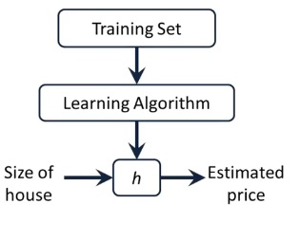
Linear Regression – Learning Algorithm

Slide 26
Linear Regression – Cost function
Cost Function:
hθ​(x)=θ0​+θ1​x
Where,
θ0 → Interception
θ1 → Slope
hθ​(x)=θ0​+θ1​x

Slide 27
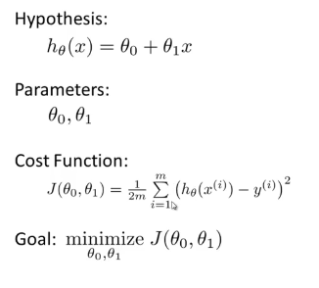
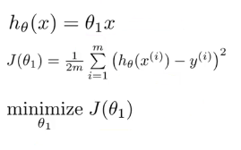
Linear Regression – Cost function
Simplified

Slide 28
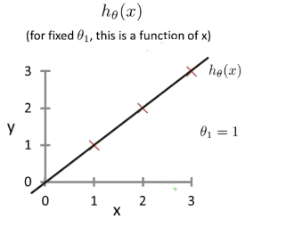
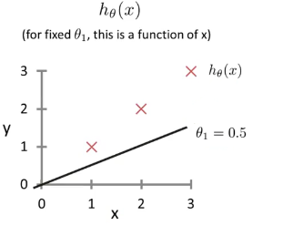
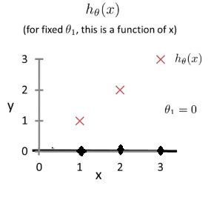
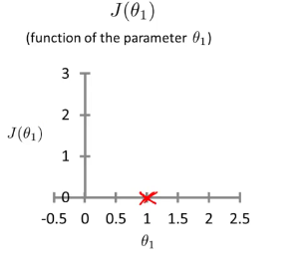
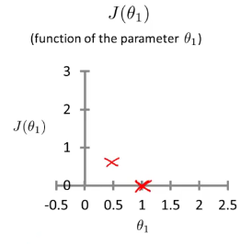
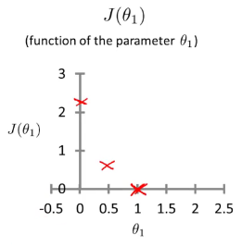
Linear Regression – Cost function

Slide 29
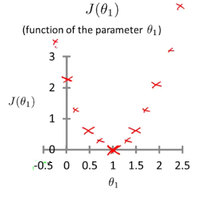
Linear Regression – Cost function

Slide 30
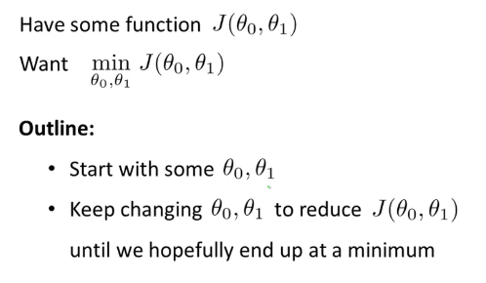
Gradient Descent
Used to minimize some cost function.
Have

Slide 31
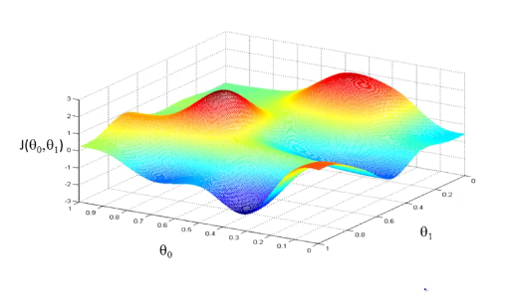
Gradient Descent Algorithm

Slide 32
Gradient Descent Algorithm

Slide 33
Gradient Descent Algorithm

Slide 34
Gradient Descent Algorithm

Slide 35
Gradient Descent Algorithm

Slide 36
Gradient Descent Algorithm

Slide 37
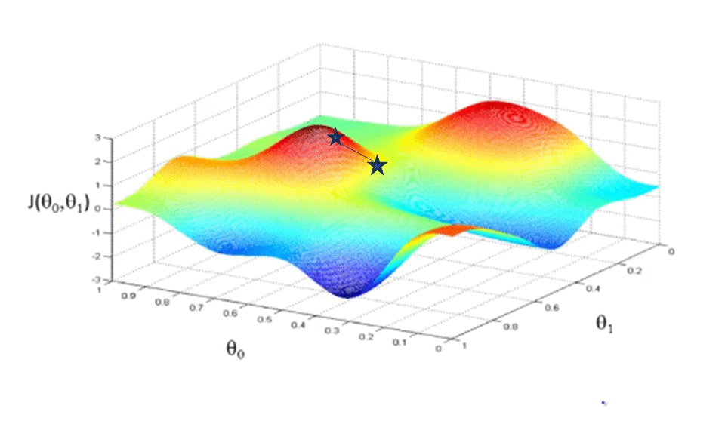
Gradient Descent Algorithm

Slide 38
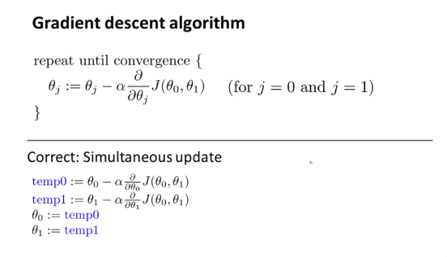
Gradient Descent Algorithm

Slide 39
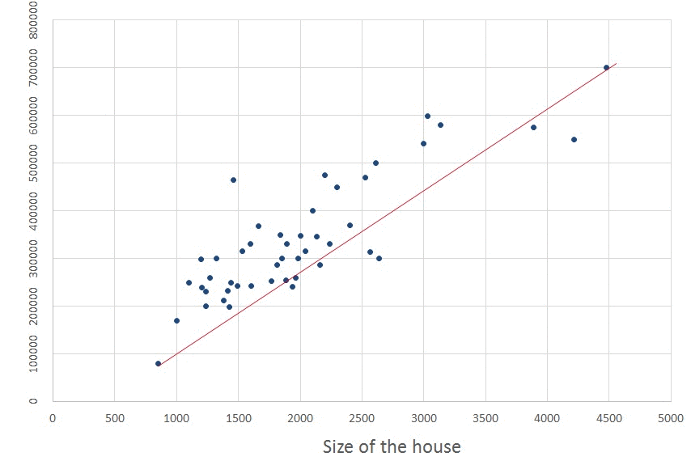
Gradient Descent Algorithm

Slide 40
Gradient Descent Algorithm
Expected Output

Slide 41
Summary
Supervised: All data is labelled and the algorithms learn to predict the output from the input data.
Unsupervised: All data is unlabelled and the algorithms learn to inherent structure from the input data.
Semi-supervised: Some data is labelled but most of it is unlabelled and a mixture of supervised and unsupervised techniques can be used.

Slide 42


